Slide 1
Bank Security
Shift-left Security: More than just a catchphrase
Vince King
January 2023

Slide 2
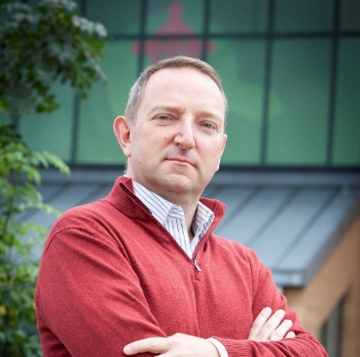






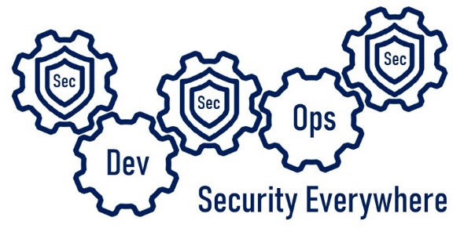

Who’s this talking to me now?
Vincent King
Senior Cyber Analyst
Head of DevSecOps
Bank of England
DevSecOpsVince
Notes:
For those of you that do not know me, my name is Vince King, and I’ve been at the Bank for almost 10 years. I’m a reformed developer, and have numerous roles including Ops Lead and DevOps subject matter expert. I moved to Cyber 4 years ago working on Vulnerability Management and have picked up a lot of experience and a few certifications.
With my experience in DevOps and Cyber Security, I’m happy to lead the effort for DevSecOps for Cloud Transformation within the Bank.

Slide 3


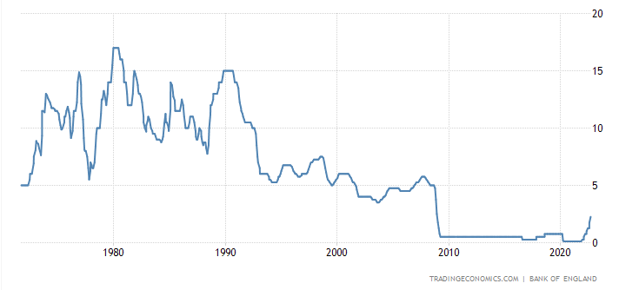

What does the Bank of England do?
3 days
left to use your paper £20 and £50 notes
Real-Time Gross Settlement
Settled an average of over £720 billion each working day
CHAPS | CREST | BACS | Image Clearing System for cheques | Faster Payments
LINK | Mastercard Europe | Visa Europe | PEXA
RTGS
Notes:
How we’re funded
Public facing
Although we are a public body, we do not get a budget from the UK Treasury. Instead, we generate the funds we need for our work by:
investing the money banks have to hold with us (this is called the 'Cash Ratio Deposit scheme')
charging the firms we regulate a fee
providing banking services to our customers, who include overseas central banks
charging for the cost of producing banknotes
charging a management fee for services we provide to government agencies
investing the capital we have built up over 300 years
The magic behind the curtains
The payments landscape continues to change at a rapid pace, reflecting changes in the needs of households and companies, changes in technology, and an evolving regulatory landscape. The Bank has operated the Real-Time Gross Settlement (RTGS) system since its introduction in 1996. RTGS lies at the heart of every payment in the UK and on average settles over £720 billion on an average day; broadly equivalent to the UK’s GDP every three days. RTGS settled £918 billion on its peak value day (31 January 2022) in the period. Banks and other financial institutions use accounts in RTGS to settle money owed to each other through the UK’s payment systems. The successful management and operation of RTGS directly supports the Bank’s mission to promote the good of the people of the United Kingdom by maintaining monetary and financial stability. As well as providing settlement services, RTGS is also the mechanism through which the Bank implements monetary policy decisions and provides liquidity to the UK’s financial system
In the 12 months to end-February 2022, RTGS settled an average of over £720 billion each working day; broadly equivalent to the UK’s GDP every three days. RTGS settled £918 billion on its peak value day (31 January 2022) in the period. The vast majority of the value settled (99%) is from CHAPS and CREST.
Now and looking into the Future
Due to the level of security around our services and the Bank’s risk-adverse attitude we became very comfortable building and running everything on premise. Our cloud adoption was also stunted by the attitudes of some executives within Technology, but the Bank is now committed to moving 80% of our services to the Cloud by 2030. So moving securely at speed is imperative.

Slide 4




Vince’s Three “i”s of Monitoring in the Cloud
Inventory
Intelligence
Insights
Notes:
Growing number of solutions
47 requirements, but here are 3 of the most important
Inventory
You can’t protect what you can’t see
Agent-based solutions do not guarantee 100% coverage
Created bespoke solution for unknown unknowns
Multi cloud only increases the issue
Should be moving away from traditional VM-based estate
Intelligence
New vulnerabilities have threat actors knocking on our doors
Time to exploit has reduced
Vulnerability data sources widely available, you can do it yourself
Insights
Risks without context are meaningless. Remember that.
CSPs highlight issues in isolation against policies
Is a missing OS patch on a VM that serious?
Following basic security principals provides layers of security
What if game .. Unpatched server … Elevation of Privilege … Pubic IP … poor SSH… lateral move?
Without context possible risk and impact may never be realised
Summary
47 requirements .. A few must haves

Slide 5

Questions?
Vincent King
Head of DevSecOps for Cloud Transformation
DevSecOpsVnce

Slide 6
DevSecOpsVince

